Slide 1

Image Classification on LC25000 Dataset
Presented By:
Mahmudul Hasan Shihan 2221081098
Jobaer Islam 2221081010
Abdur Razzak 2221081081
Nusrat Tabassum Nabila 2221081101
Presented To:
Samia Yasmin
Lecturer, UU
Date: 13/05/2025

Slide 2
Introduction
Objectives
Motivation
Challenges
Outline-
Dataset (LC25000)
Model
Result
Future Work
Limitation
Conclusion

Slide 3
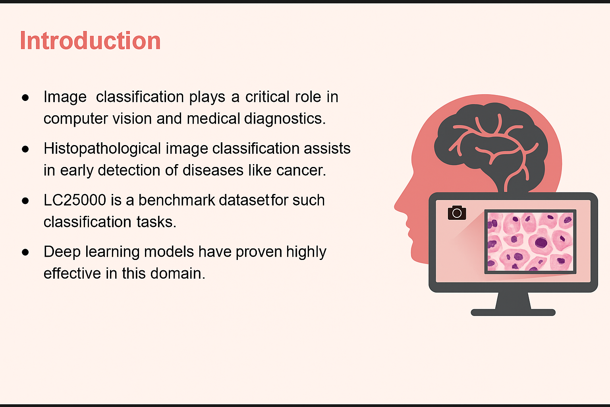
dataset for
01

Slide 4
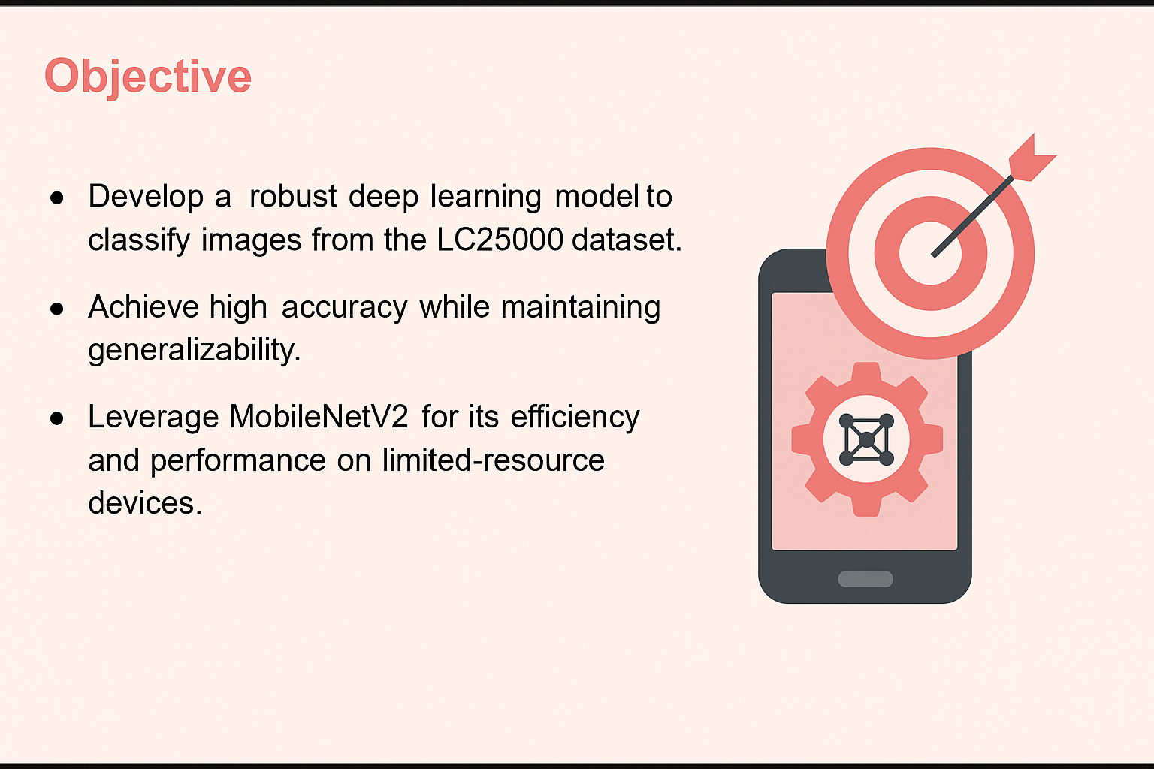
02

Slide 5
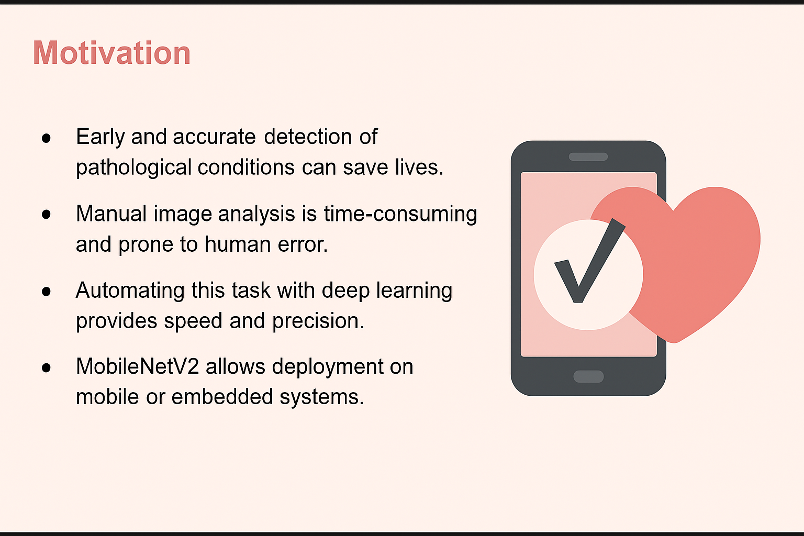
03

Slide 6

Challenges
High visual similarity between benign
and malignant tissues.
Imbalanced data distribution across
classes.
Risk of overfitting due to high model
capacity.
04

Slide 7

Dataset Description (LC25000)
Source: LC25000 dataset (collected from
histopathological images).
Total Images: 25,000
5,000 per class (5 classes: colon adenocarcinoma,
lung adenocarcinoma, etc.)
Image Size: 224x224 pixels
Preprocessing: Normalization, resizing,
data augmentation
05

Slide 8
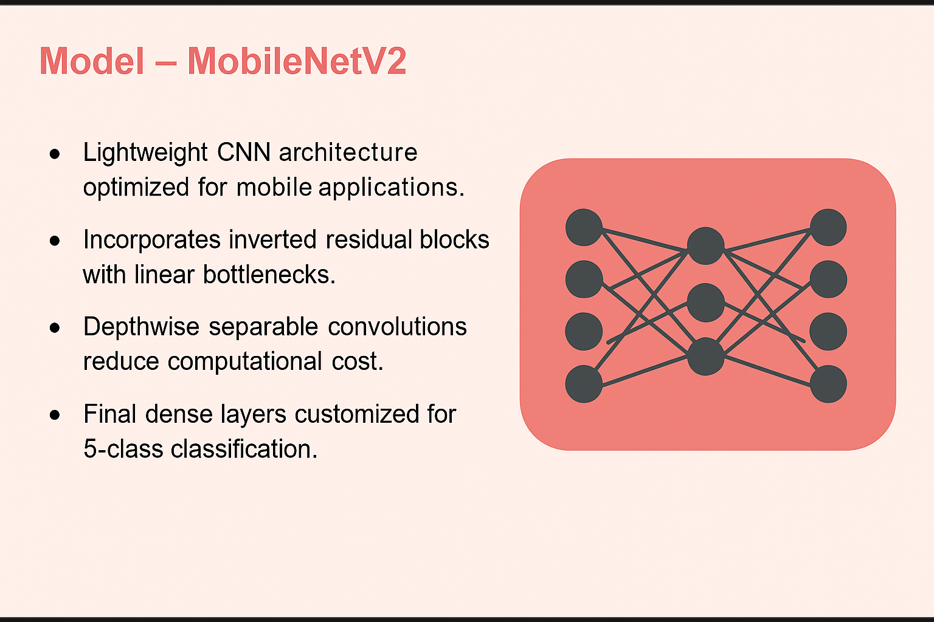
06

Slide 9
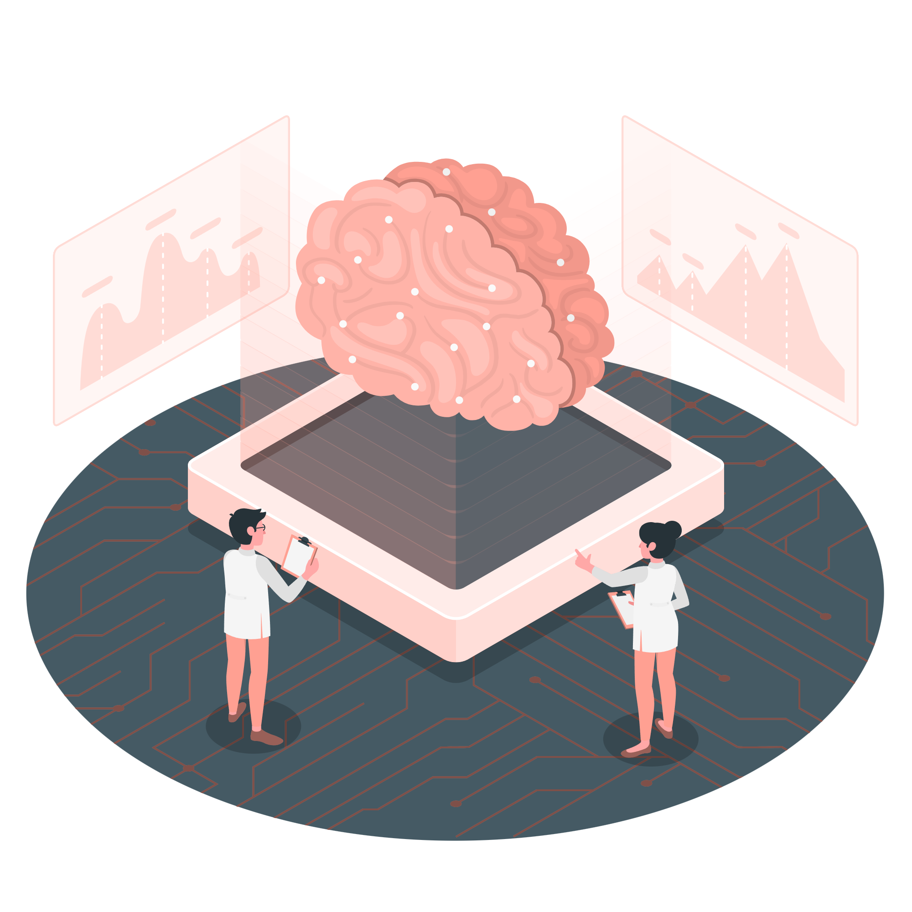
Why MobileNetV2?
Efficient in terms of parameters and
computational resources.
Performs well on image
classification tasks with high accuracy.
Suitable for deployment in real-world,
resource-constrained settings.
Proven effectiveness in medical
image analysis.
07

Slide 10
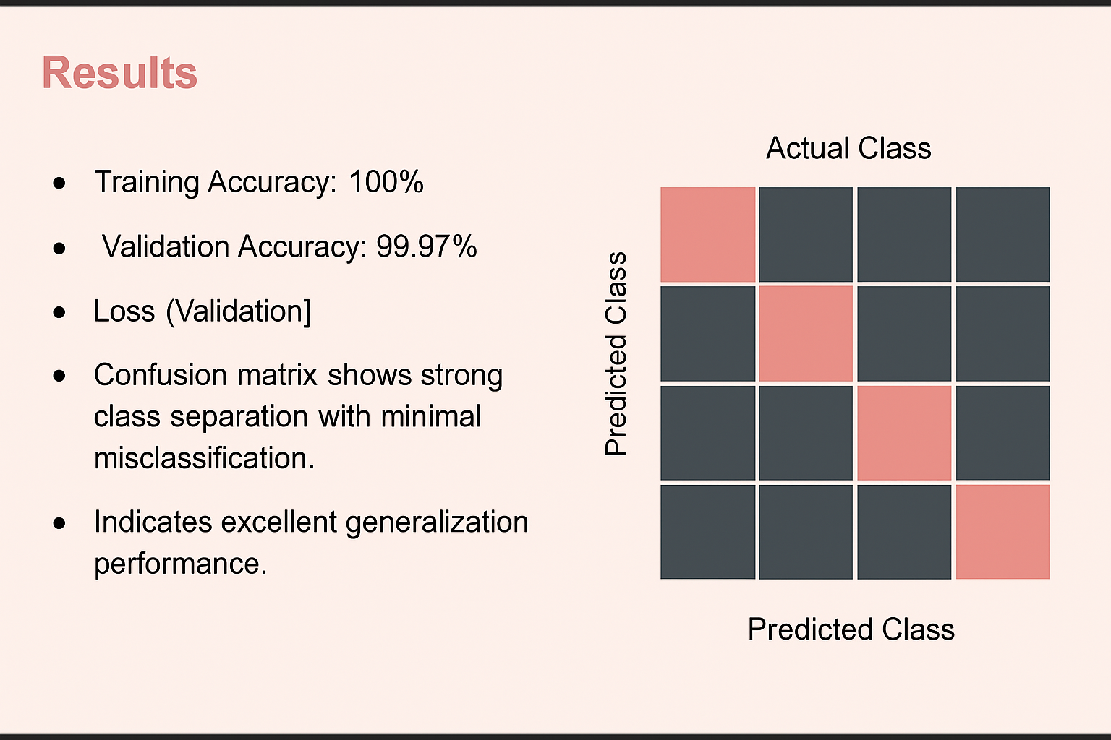
08

Slide 11

Future Work
Integrate Federated Learning (FL):
Enable collaborative model training across multiple
medical institutions without sharing patient data.
Improve data privacy and compliance with
healthcare regulations (e.g., HIPAA, GDPR).
Enhance generalization by learning from diverse,
decentralized datasets.
09

Slide 12
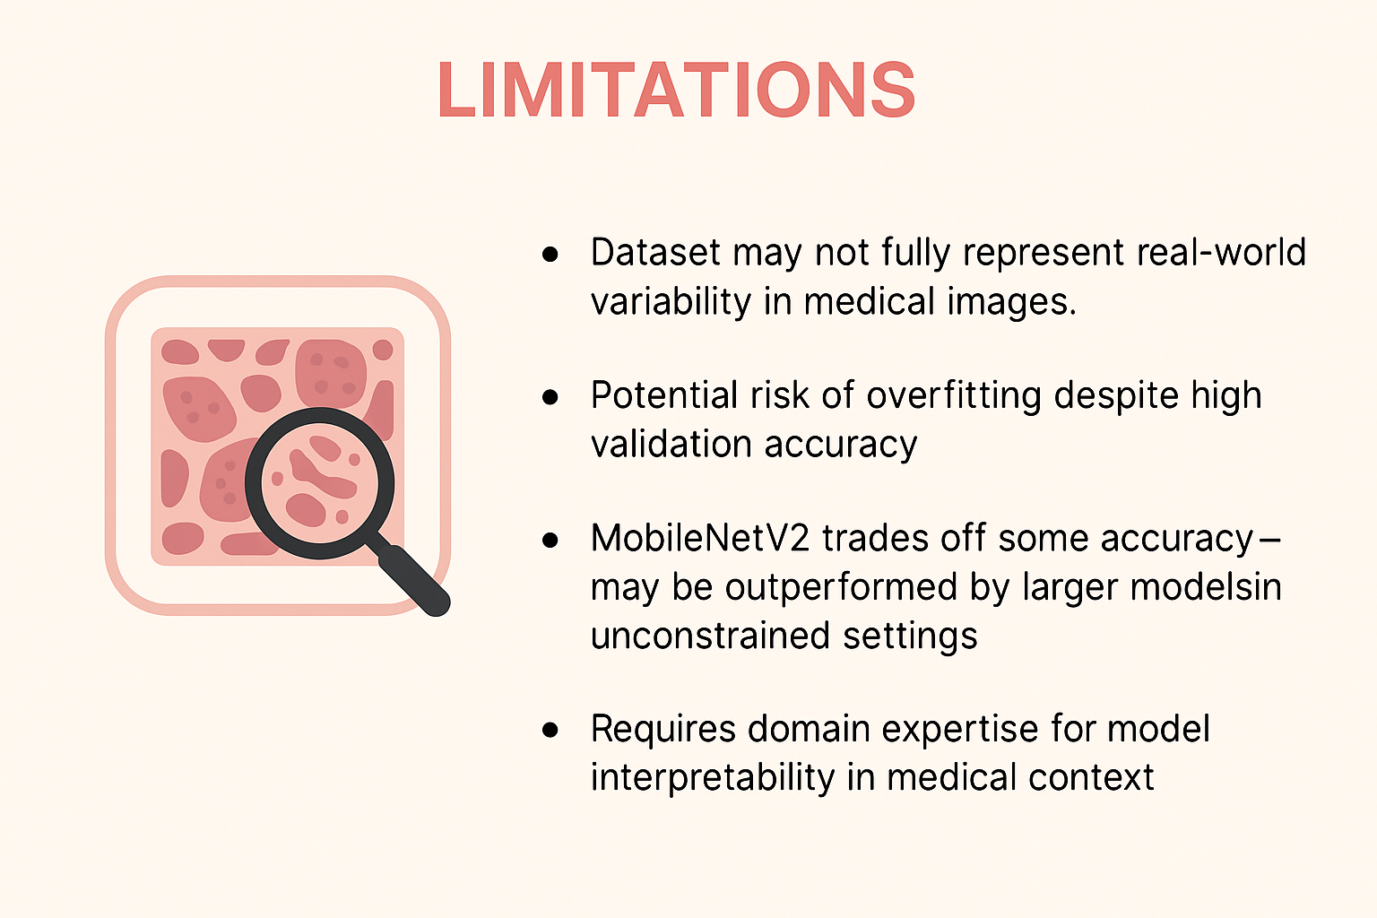
Limitation
10

Slide 13
Conclusion
Successfully developed an image classification model using
MobileNetV2 on LC25000.
Achieved exceptional performance with 99.97% validation accuracy.
Demonstrated feasibility of using lightweight CNNs for medical
image classification.
Opens doors for future deployment and clinical integration.
11

Slide 14

Thank You!

